Slide 1
Object oriented analysis and design
Module 3: Use-Case Modeling

Slide 2
Objectives
Describe system behavior and show how to capture it in a model.
Demonstrate how to read and interpret:
A use-case diagram
An activity diagram

Slide 3
Where Are We?
Concepts in use-case modeling
Use-case diagrams
Activity diagrams

Slide 4
What Is System Behavior?
System behavior is how a system acts and reacts.
It comprises the actions and activities of a system.
System behavior is captured in use cases.
Use cases describe the interactions between the system and (parts of) its environment.

Slide 5
What Is a Use-Case Model?
A model that describes a system’s functional requirements in terms of use cases.
A model of the system’s intended functions (use cases) and its environment (actors).
View Report Card
Register for Courses
Student
Login

Slide 6
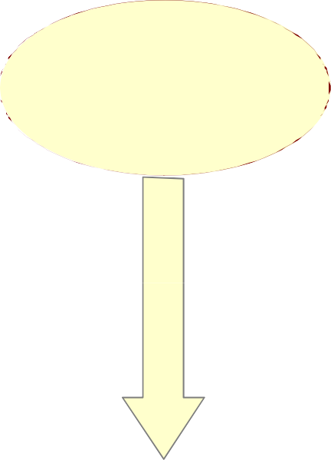
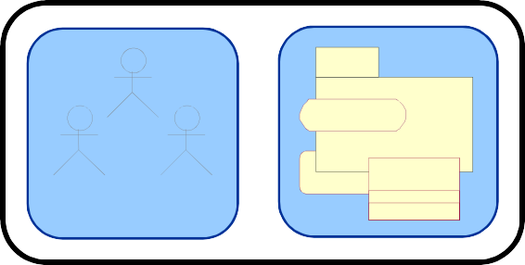

What Are the Benefits of a Use-
Case Model?
Use Case
Communication
Identification
Verification
End User
Domain Expert
Users

Slide 7
Major Concepts in Use-Case
Modeling
An actor represents anything that interacts with the system.
Actor
A use case describes a sequence of events, performed by the system, that yields an observable result of value to a particular actor.
Use Case

Slide 8
Where Are We?
Concepts in use-case modeling
Use-case diagrams
Activity diagrams

Slide 9
What Is an Actor?
Actors represent roles a user of the system can play.
They can represent a human, a machine, or another system.
They can actively interchange information with the system.
They can be a giver of information.
They can be a passive recipient of information.
Actors are not part of the system.
Actor
– Actors are EXTERNAL.

Slide 10
What Is a Use Case?
Defines a set of use-case instances, where each instance is a sequence of actions a system performs that yields an observable result of value to a particular actor.
A use case models a dialogue between one or more actors and the system
A use case describes the actions the system takes to deliver something of value to the actor
Use Case

Slide 11
Use Cases and Actors
A use case models a dialog between actors and the system.
A use case is initiated by an actor to invoke a certain functionality in the system.
Use Case
Association
Actor

Slide 12
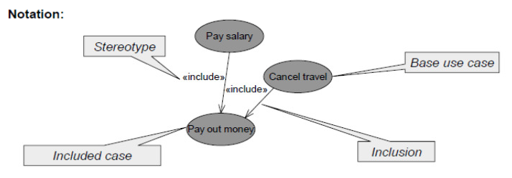
Include Use Cases
Include means the inclusion of particular action sequences in the base use case.
The included use case can be used independent of the base use cases.

Slide 13
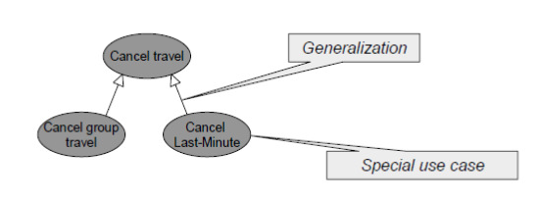
Generalization of Use Cases
Generalization correlates (taxonomically) more specialized use cases and more general ones. The special case inherits every property from the general and adds incrementally further properties or replaces them.

Slide 14
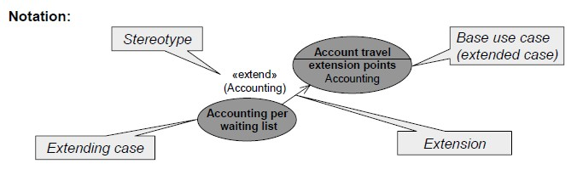
Extend Use Cases
Extensions define variations and special cases with the meaning, that the extending case completes the base use case, i.e., may be inserted in the behavior of the base case.
Extensions are included, maybe optional, at extension points.
A use case may have many extension points
An extending use case may extend one or more of these extension points

Slide 15
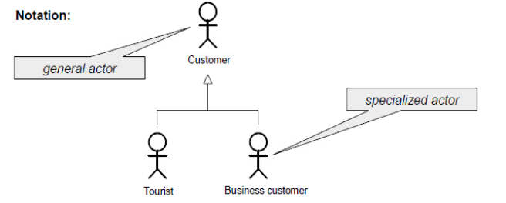
Generalization of Actors
Actors may have a taxonomic relationship.
In use case diagrams the taxonomy is usually not shown. Separate actor diagrams show the relationships between actors.

Slide 16
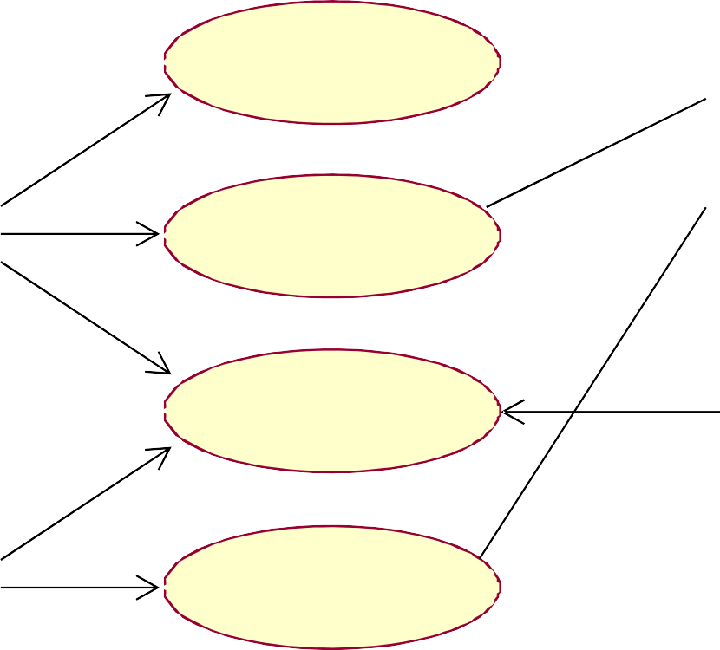
How Would You Read This
Diagram?
View Report Card
Course Catalog
Maintain Professor Information
Register for Courses
Student
Login
Maintain Student Information
Registrar
Select Courses to Teach
Close Registration
Professor
Submit Grades
Billing System

Slide 17
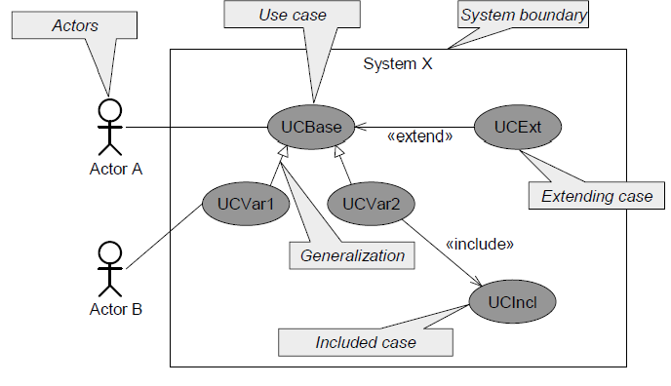
Summary of Concepts

Slide 18
Where Are We?
Concepts in use-case modeling
Use-case diagrams
Activity diagrams

Slide 19
What Is an Activity Diagram?
An activity diagram in the use-case model can be used to capture the activities and actions performed in a use case.
It is essentially a flow chart, showing flow of control from one activity or action to another.

Slide 20
What Is an Activity?
A specification of behavior expressed as a flow of execution via sequencing of subordinate units.
– Subordinate units include nested activities and ultimately individual actions.
May contain boolean expression constraints when the activity is invoked or exited

Slide 21

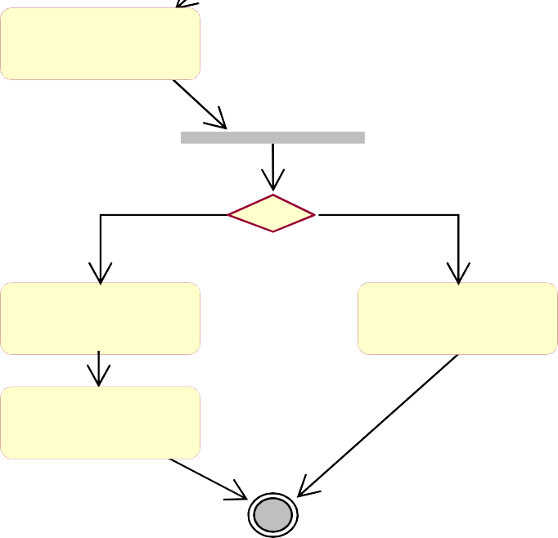
Example: Activity Diagram
Decision
Concurrent Threads
Select Course
[ delete course ]
Delete Course
[ add course ]
Synchronization Bar (Fork)
Guard Condition
Check Schedule
Check
Pre-requisites
Synchronization Bar (Join)
[ checks completed ]
[ checks failed ]
Assign to Course
Resolve Conflicts
Transition
Update Schedule

Slide 22
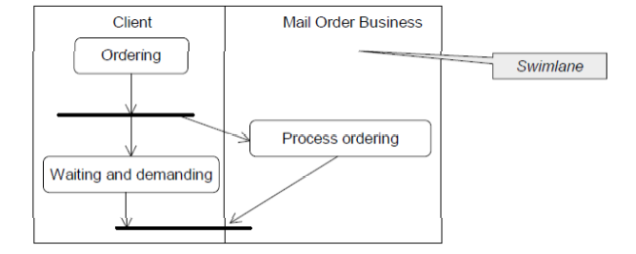
Swimlanes
A swimlane shows the actions and activities being executed by a unit, an object or a class, mostly concurrent to other actions/activities.

Slide 23
Review
What is system behavior?
What is a use-case model? What are its benefits?
What is an actor? A use case?
What is an activity diagram?

